Slide 1
Online Chinese Character Handwriting Recognition for Linux
Presenter: Ran CHENG (Kelvin)
Primary Supervisor: Jim Hogan
Associate Supervisor: Jinhai Cai

Slide 2
Content
Background
Introduction
Related material
Handwriting Recognition System
Evaluation
Future work

Slide 3
Background
Why?
  Why handwriting?
    One of most important input methods
  Why Chinese character?
    Potential Large market
    One of the I18N goals
  Why online?
    Only feasible runtime Input method
    Frequently used
  Why Linux?
    Fast developing OS
Who?
  Who is the sponsor?
    Redhat Linux
What?
  What will be the deliverables?
    One handwriting software prototype
    A feasible handwriting recognition algorithm

Slide 4
Introduction
Handwriting types
  Online
  Offline
  Signature
The current online Chinese handwriting market
  Most are commercial, not open source
  Some existing open source, but not Chinese
Aim:
  Online Handwriting recognition and recognition accuracy
  Recognition for Chinese Character
  Implementation of handwriting recognition algorithm under Linux

Slide 5
Related material
Hidden Markov Model (HMM)
Chinese Character Processing

Slide 6
Hidden Markov Model (HMM)
What is HMM?
  Markov process with unknown parameters
  challenge is to determine the hidden parameters from the observable sequence
Example
  Two people in different city {Bob, Carol}
  Talk through the phone
  Weather and activities
    {Sunny, Rainy, Cloudy} {Walk, Shopping, Cleaning}

Slide 7
Chinese Character Processing
Character segmentation
Pre-processing
Pattern Representation
Classification
Context processing

Slide 8
Handwriting Recognition System
Writing pad
Data collection, organization and format
Feature analysis
Training state initialisation and optimisation
Character recognition

Slide 9
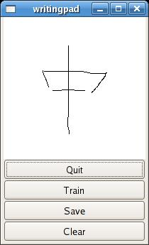
Writing pad
Basic functions
Taking input from user

Slide 10
Data collection
42 Chinese characters for 43 strokes and variations
  all the Chinese character strokes
  frequently used characters
From 5 different people
40 training examples for each character

Slide 11
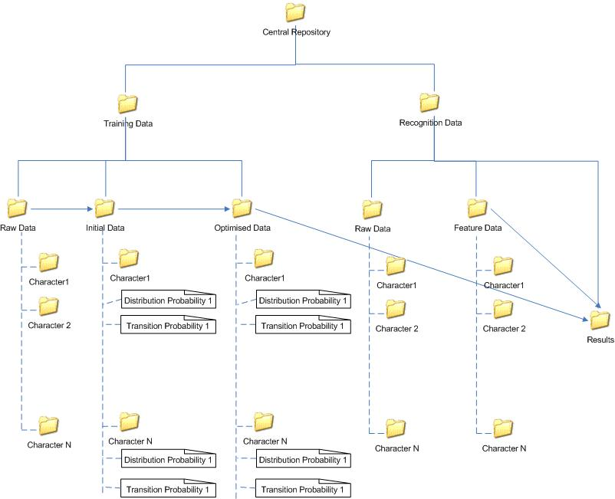
Data organization

Slide 12
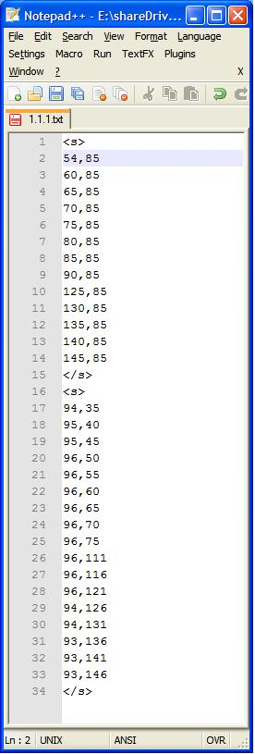
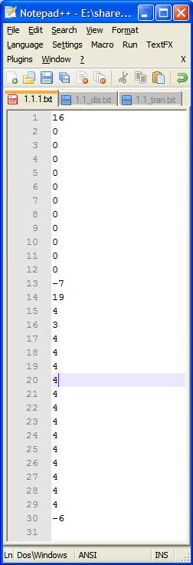
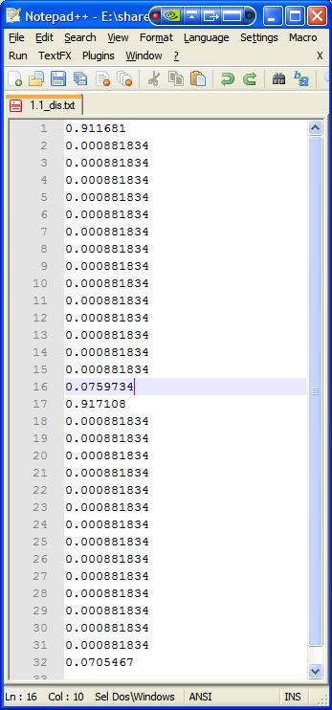
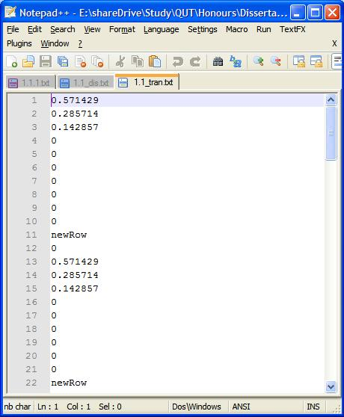
Data format

Slide 13
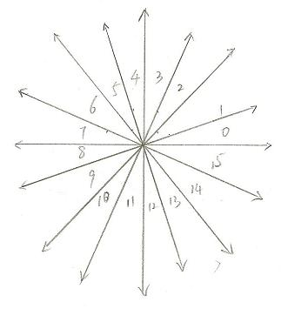
Feature analysis
Character decomposition
  Each stroke is represented by 5 states
State decomposition
  Each state contains statistic distribution probability of 16 features

Slide 14
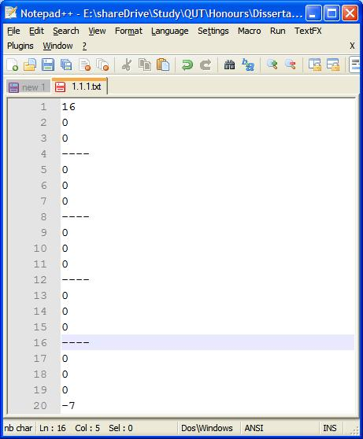
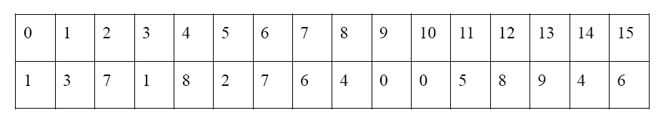
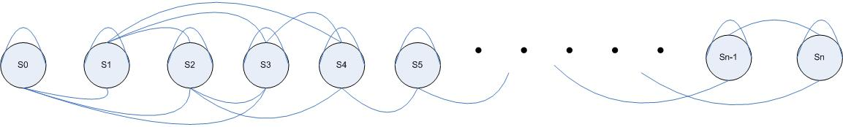
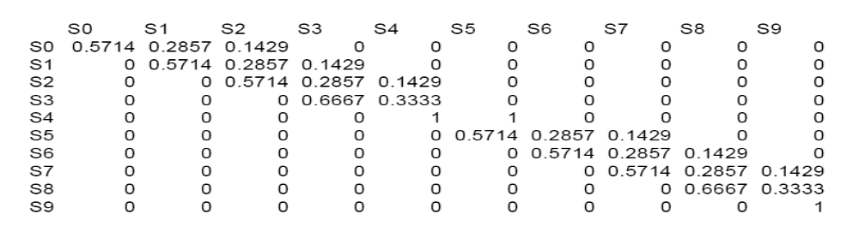
Training state initialisation
Observation segmentation
Feature distribution
State Transition

Slide 15
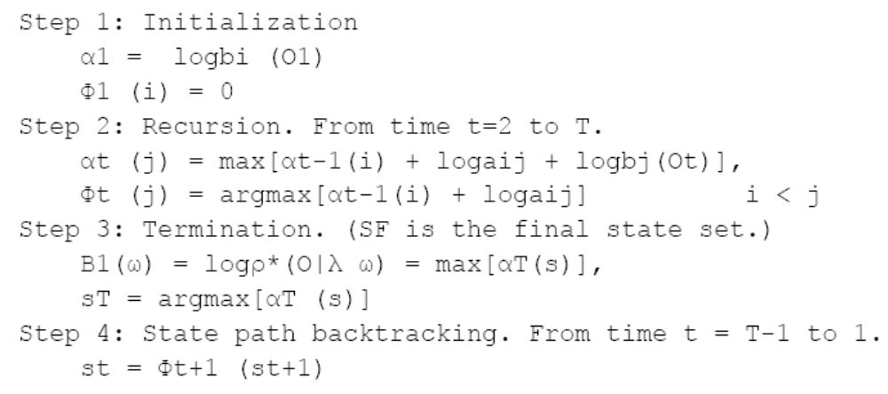
Training state optimisation
Viterbi algorithm

Slide 16
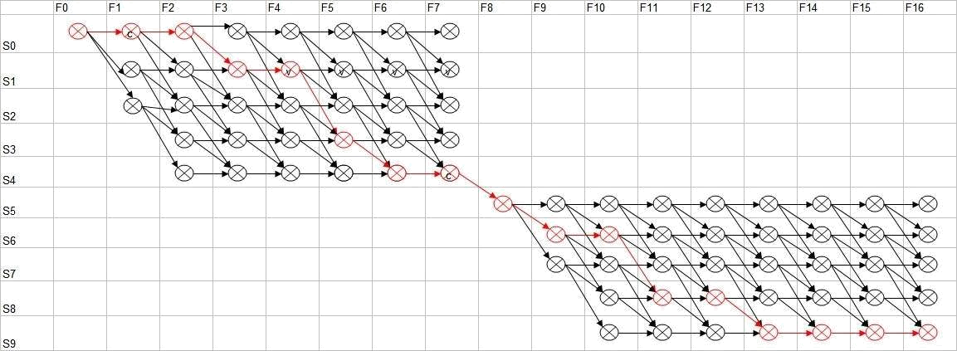
Training state optimisation (Continue)

Slide 17
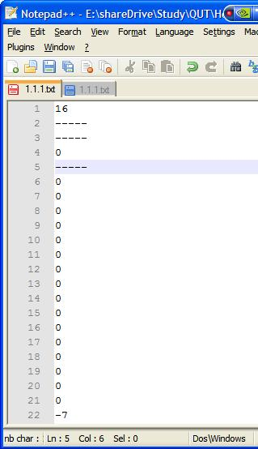
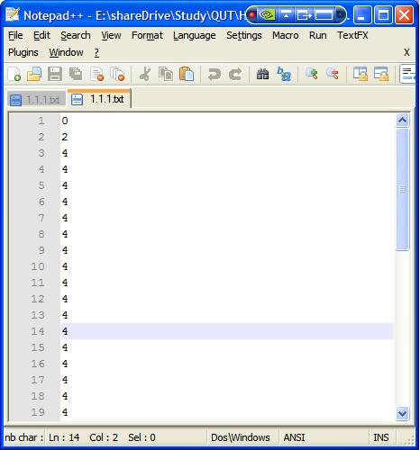
Training state optimisation (Continue)
Observation segmentation
Feature distribution
State Transition

Slide 18
Character recognition
Create a ranking list.
Pick up a reserved input file as the observation file in the Viterbi algorithm.
Pick up the distribution probability and transition probability files for a character stored in the database or file system.
Run the Viterbi algorithm and record the overall probability (we only used the overall path in the state transition optimisation, and only use overall probability here).
According to the probability, insert the character at the proper position into the ranking list.
Repeat step 2 to 5 until no more character data is left in the database or file system.

Slide 19
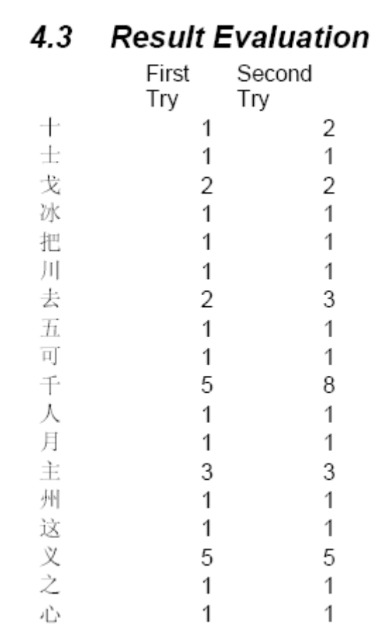
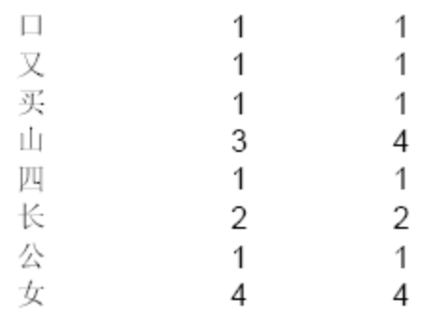
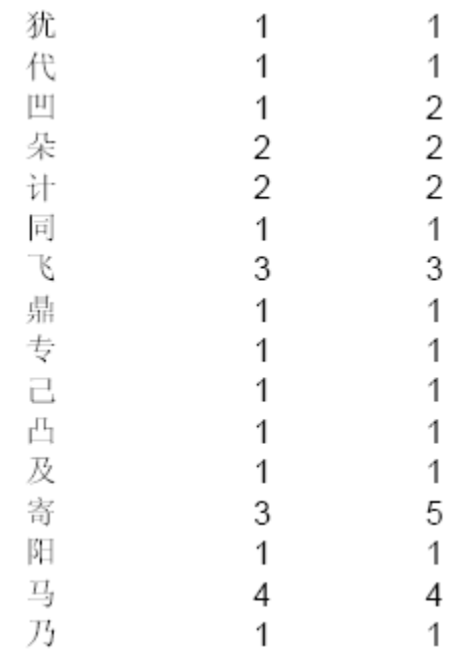
Evaluation
67% (56/84) of the characters are correctly recognised
98.8% (83/84) of the character are recognised in the top five positions

Slide 20
Future work
Writing Pad XInput support
Relative position handling
  For instance, “工” and “土”
Duration handling
  For instance, “士” and “土”

Slide 21
Questions?

Slide 22
Thank you

